Slide 1
DNN-Based Stock Prediction
PRESENTED BY:-
KIMAYA BHAVE(1032222235)
RISSHI BHAGAT(1032220478)

Slide 2
Introduction
Stock markets are highly volatile and influenced by complex patterns.
Traditional linear models fail to capture non-linear relationships in financial data.
The objective of this project is:
  To predict next-day stock closing prices
  To convert predictions into a trading strategy
  To evaluate performance with risk management

Slide 3
Data preprocessing
  CREATED 1-DAY LAG FEATURES TO PREVENT DATA LEAKAGE
  USED PREVIOUS DAY’S VALUES AS MODEL INPUTS
  CALCULATED TECHNICAL INDICATORS
  REMOVED ROWS WITH MISSING VALUES
  PERFORMED TIME-SERIES AWARE TRAIN-TEST SPLIT
THE SAME IS SHOWN AHEAD WITH SOME CODE SINPPETS FOR BETTER UNDERSTANING

Slide 4
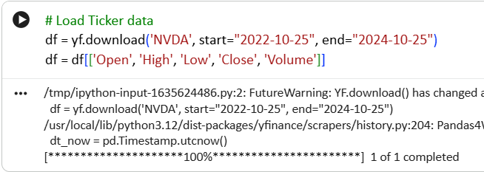
Data collection
HISTORICAL STOCK DATA WAS COLLECTED USING YAHOO FINANCE.
STOCK USED: NVIDIA (NVDA)
PERIOD: 2022 – 2024

Slide 5
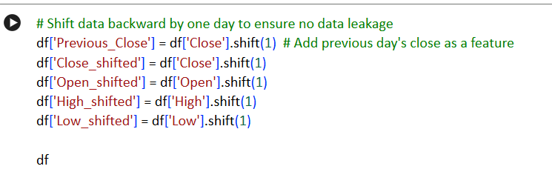
Preventing data leakage
We created lag features so the model only sees past data.

Slide 6
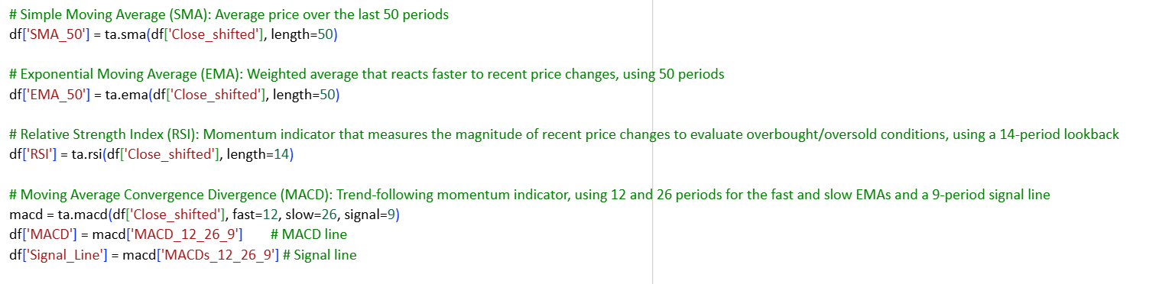
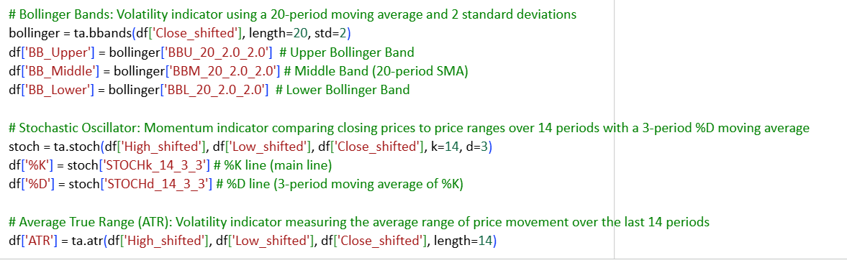
Technical indicators

Slide 7
Technical indicators
  SIMPLE MOVING AVERAGE (SMA)
  EXPONENTIAL MOVING AVERAGE (EMA)
  RELATIVE STRENGTH INDEX (RSI)
  MACD & SIGNAL LINE
  BOLLINGER BANDS
  STOCHASTIC OSCILLATOR (%K, %D)
  AVERAGE TRUE RANGE (ATR)
  PREVIOUS CLOSE PRICE
THESE INDICATORS CAPTURE TREND, MOMENTUM, AND VOLATILITY.
Why technical indicators?
  PROVIDE MATHEMATICAL REPRESENTATION OF PRICE BEHAVIOR
  CAPTURE TREND DIRECTION
  IDENTIFY OVERBOUGHT/OVERSOLD CONDITIONS
  MEASURE VOLATILITY
  IMPROVE MODEL LEARNING

Slide 8
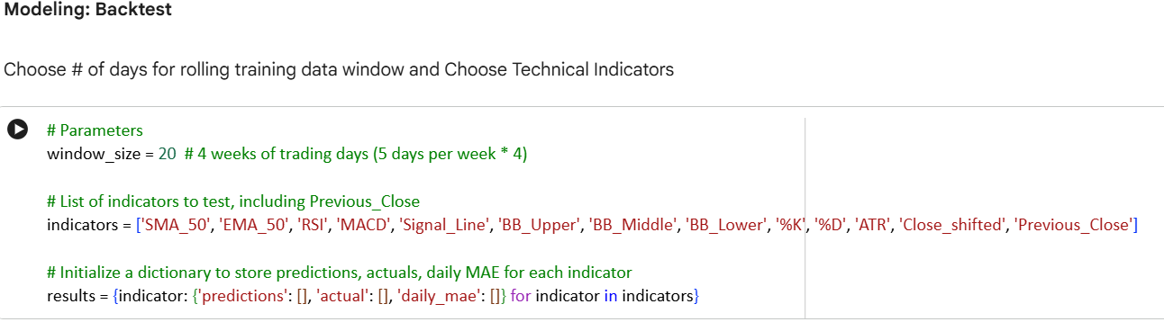
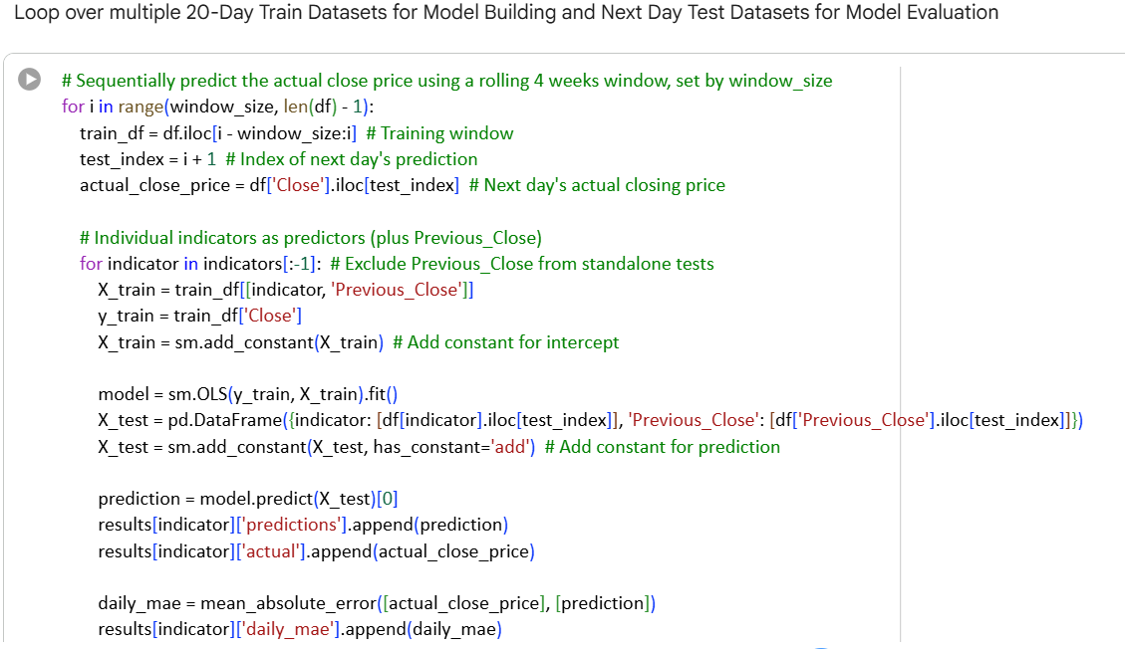
Modelling Backtest

Slide 9
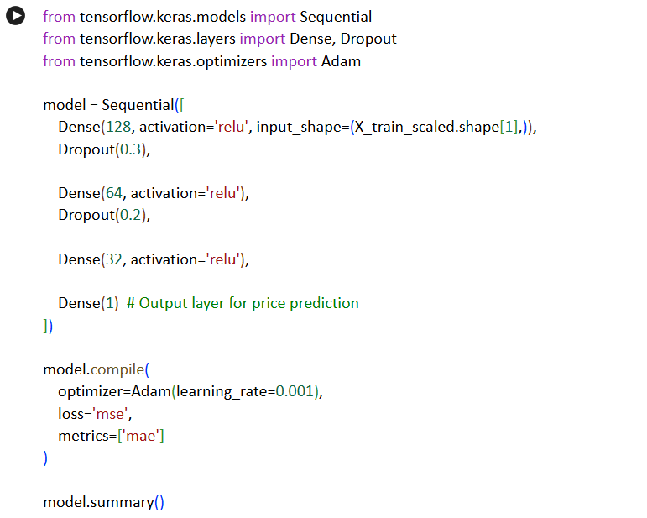
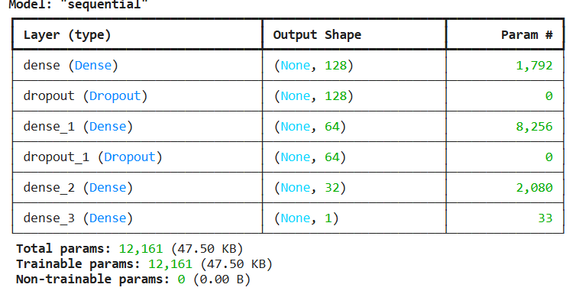
Model Architeture
  INPUT LAYER: TECHNICAL INDICATORS
  HIDDEN LAYER 1: 128 NEURONS (RELU)
  DROPOUT LAYER (PREVENTS OVERFITTING)
  HIDDEN LAYER 2: 64 NEURONS (RELU)
  HIDDEN LAYER 3: 32 NEURONS (RELU)
  OUTPUT LAYER: 1 NEURON (NEXT-DAY CLOSE PRICE)
  LOSS FUNCTION: MEAN SQUARED ERROR
  OPTIMIZER: ADAM

Slide 10
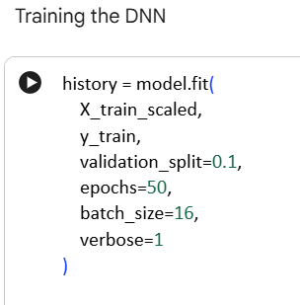
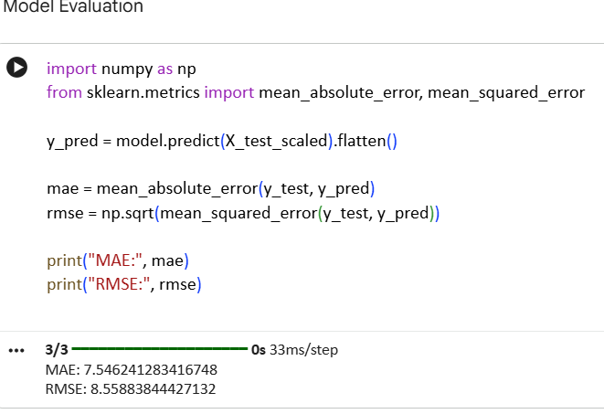
Training Process and Model Evaluation

Slide 11
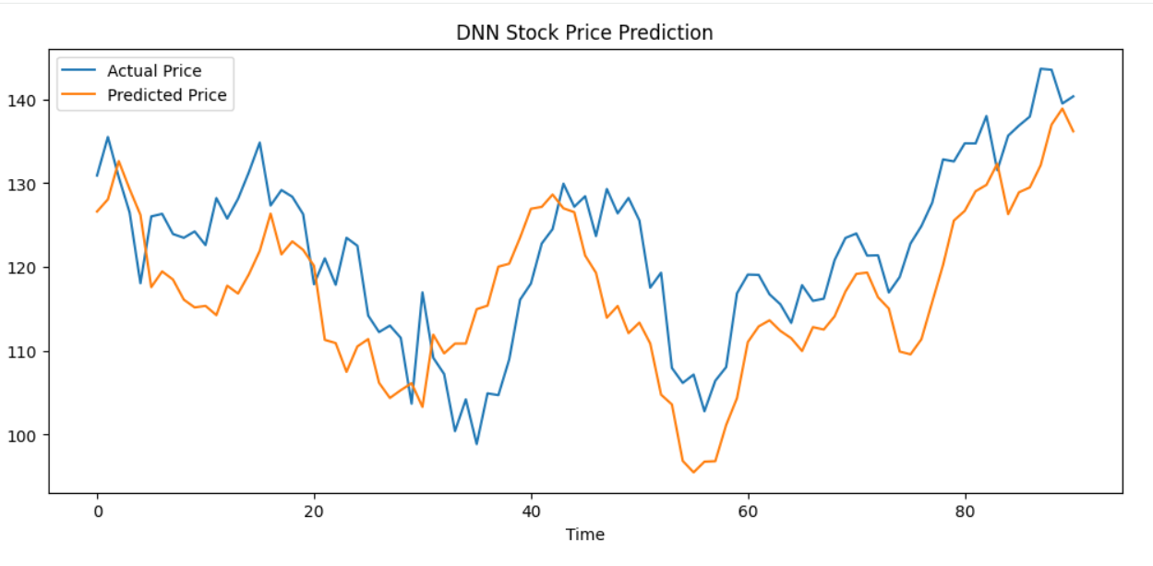
Visualisation

Slide 12
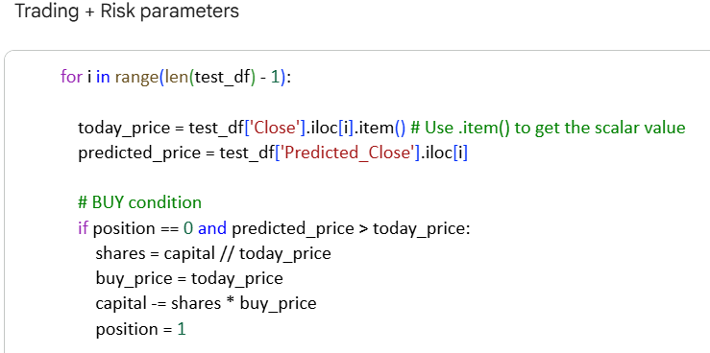
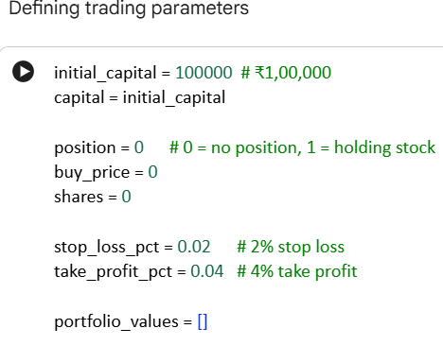
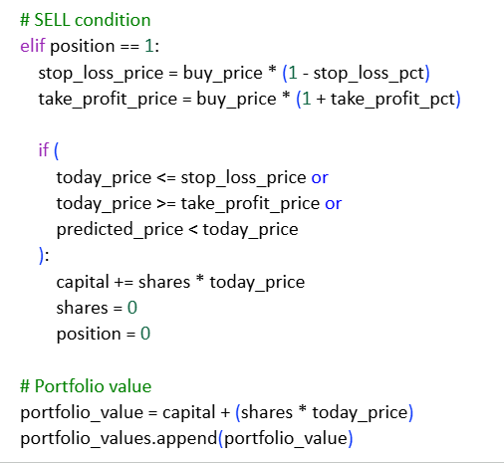
STOP-LOSS:
  LIMITS DOWNSIDE RISK
  PROTECTS CAPITAL
TAKE-PROFIT:
  LOCKS IN GAINS
  AVOIDS EMOTIONAL TRADING
  RISK MANAGEMENT IMPROVES LONG-TERM STABILITY.
Trading strategy and risk management
BUY WHEN:
PREDICTED PRICE > CURRENT PRICE
SELL WHEN:
STOP-LOSS TRIGGERED (−2%)
TAKE-PROFIT TRIGGERED (+4%)
MODEL PREDICTS PRICE DROP

Slide 13
Results and challanges faced
RESULTS
  DNN SUCCESSFULLY PREDICTED PRICE TRENDS
  TRADING STRATEGY GENERATED COMPETITIVE RETURNS
  RISK-MANAGED APPROACH REDUCED DRAWDOWNS
  MODEL OUTPERFORMED BASIC LINEAR MODELS
CHALLENGES
  MARKET VOLATILITY
  OVERFITTING RISK
  FEATURE SCALING ISSUES
  AVOIDING DATA LEAKAGE

Slide 14
Future Improvement and conclusion
FUTURE IMPROVEMENT
  LSTM SEQUENCE MODELING
  MULTI-STOCK GENERALIZATION
  SHARPE RATIO & MAX DRAWDOWN ANALYSIS
  DIRECTION CLASSIFICATION MODEL
  REAL-TIME DEPLOYMENT
CONCLUSION
  DEEP NEURAL NETWORKS EFFECTIVELY MODEL STOCK PRICE BEHAVIOR
  TECHNICAL INDICATORS ENHANCE PREDICTIVE POWER
  CONVERTING PREDICTIONS INTO TRADING STRATEGY INCREASES PRACTICAL VALUE
  RISK MANAGEMENT IS ESSENTIAL IN FINANCIAL MODELING

Slide 15
Thank You

